Slide 1

Minor Project ( CS1634 )
BY:
Vimal Subbiah
189301026
VI-CSE D

Slide 2
Text to Image Generation using GANs

Slide 3
Stacked Generative Adversarial Networks (StackGAN) with Conditioning Augmentation for synthesizing photo-realistic images which will be the focus of this project along with its comparison to the common DC-GAN put to the same task and how they matchup against each other and get statistical results

Slide 4
What exactly are GANs ?
GANs are a clever way of training a generative model by framing the problem as a supervised learning problem with two sub-models: the generator model that we train to generate new examples, and the discriminator model that tries to classify examples as either real (from the domain) or fake (generated). The two models are trained together in a zero-sum game, adversarial, until the discriminator model is fooled about half the time, meaning the generator model is generating plausible examples.

Slide 5
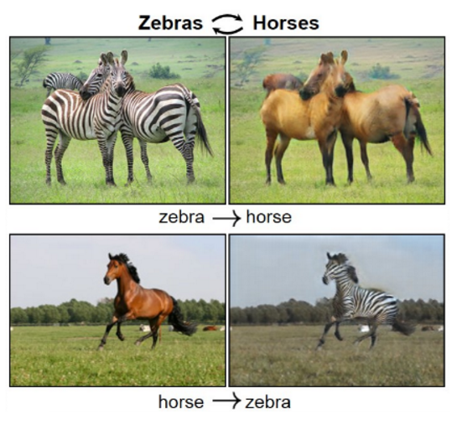
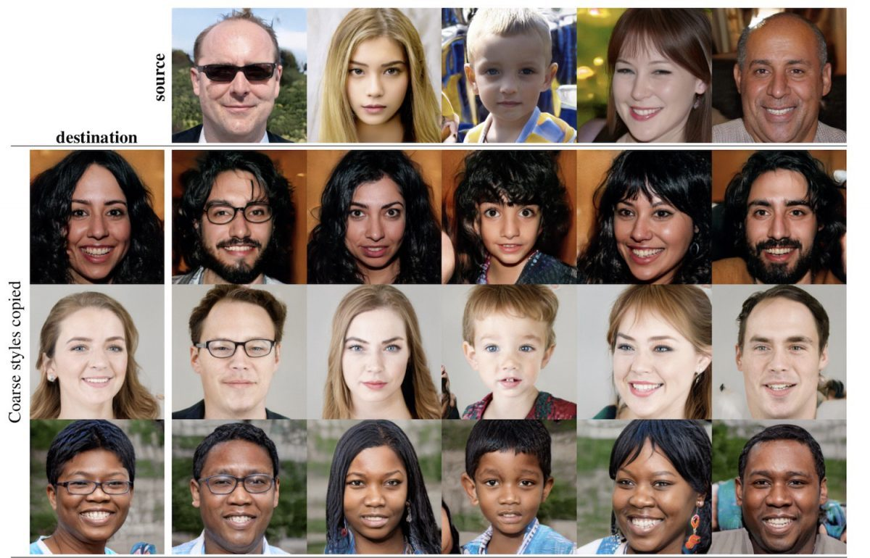
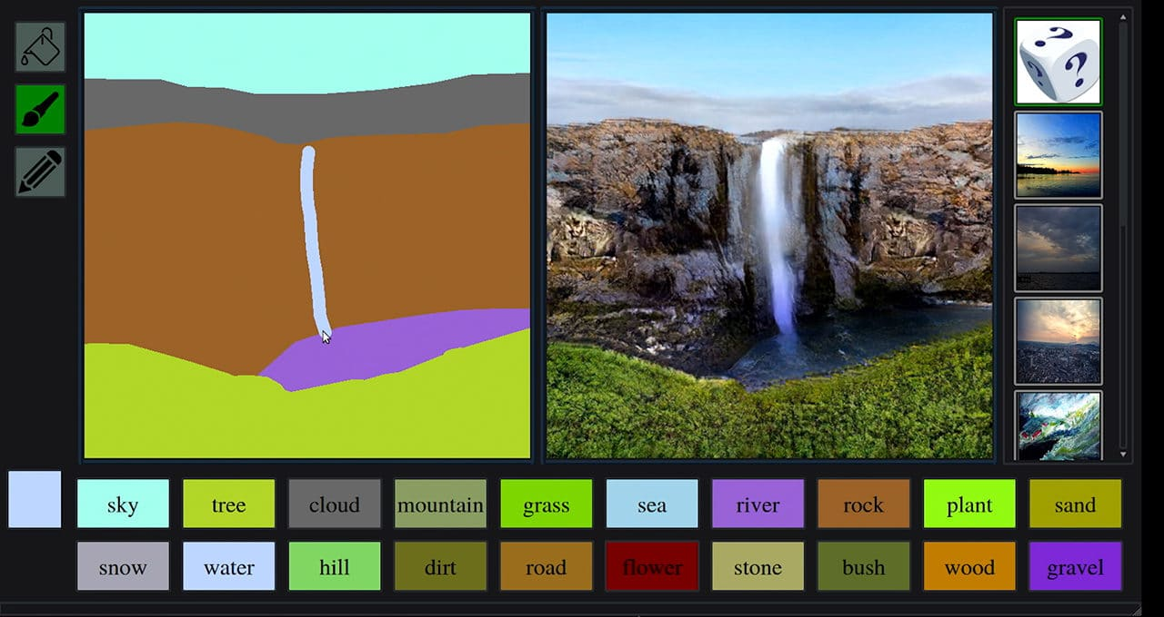
Some Applications of GANs
Neural style transfer via CycleGAN
Nvidia’s StyleGAN to generate faces
Nvidia’s GauGAN

Slide 6
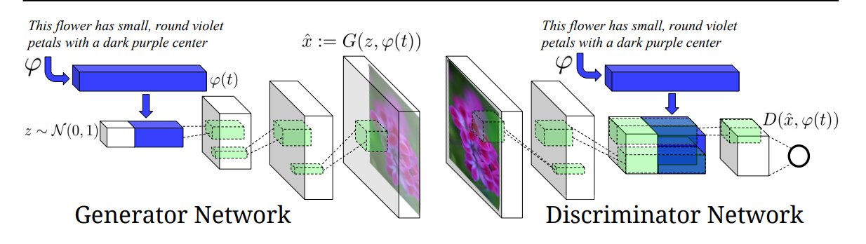
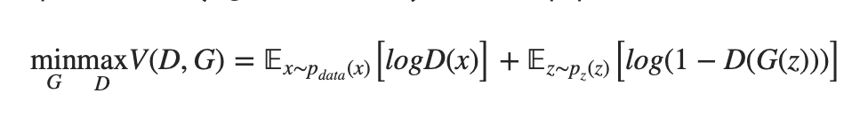
But how would we generate Images from text using GANs ?
The Loss function is given by :

Slide 7
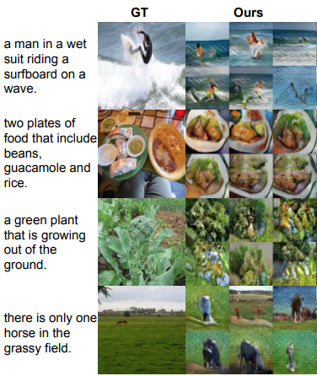
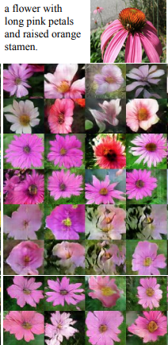
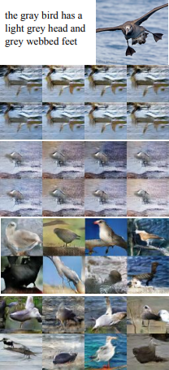
Generated Images from the DC-GAN
A collection of generated images
(64x64) on MS-COCO , CUB and Oxford 102

Slide 8
Quick Side note about these datsets
These datasets were used for training throughout this project and here’s a small description of them.
Statistics of datasets. We do not split ImageNet because it is utilized for the unconditional tasks.

Slide 9
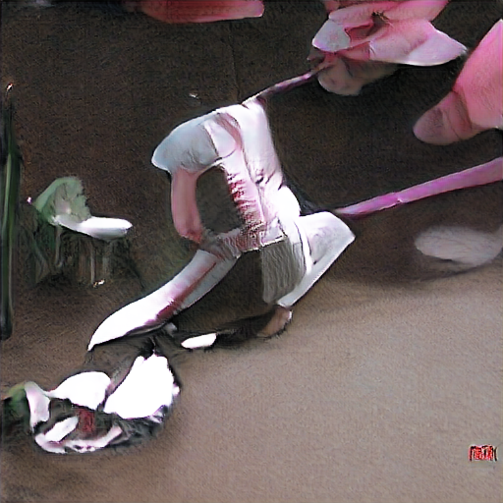
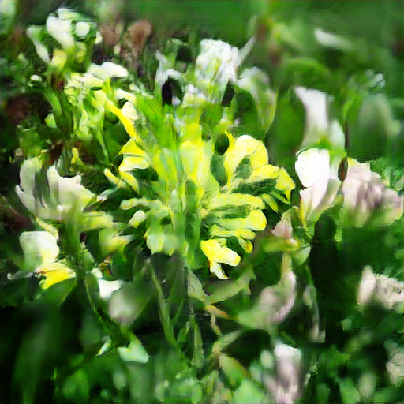
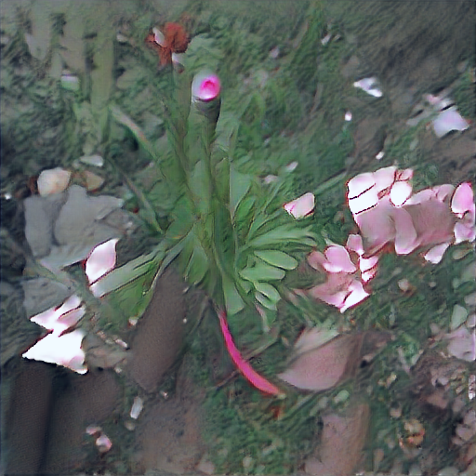
So, what are the drawbacks for this ?
It is very difficult to train GAN to generate high-resolution photo-realistic images from text descriptions.
Simply adding more upsampling layers in state-ofthe-art GAN models for generating high-resolution (e.g., 256×256) images generally results in training instability and produces nonsensical outputs.
Same textual input as (b)
Generated nonsensical
Outputs as these

Slide 10
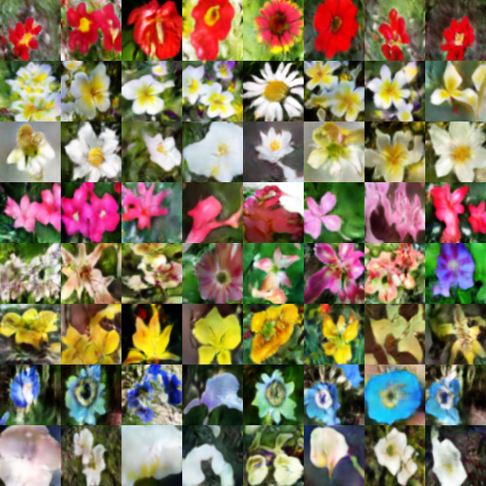
The main difficulty for generating high-resolution images by GANs is that supports of natural image distribution and implied model distribution may not overlap in high dimensional pixel space.
The Images generated are low res (64x64) and majorly lots of features are hard to tell.
Highest quality of images generated by the Oxford 102 dataset

Slide 11
StackGANs
So, How do we improve this ?
By implementing …

Slide 12
What exactly is a StackGAN ?
To generate high-resolution images with photo-realistic details, we propose a simple yet effective Stacked Generative Adversarial Networks. It decomposes the text-to-image generative process into two stages (see Figure 2). –
Stage-I GAN: it sketches the primitive shape and basic colors of the object conditioned on the given text description, and draws the background layout from a random noise vector, yielding a low-resolution image.
Stage-II GAN: it corrects defects in the low-resolution image from Stage-I and completes details of the object by reading the text description again, producing a highresolution photo-realistic image.

Slide 13
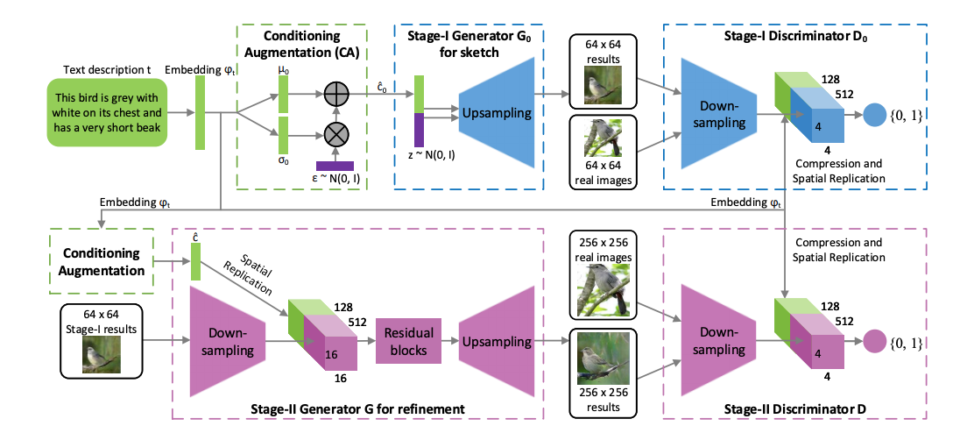
So ,how does it work?

Slide 14
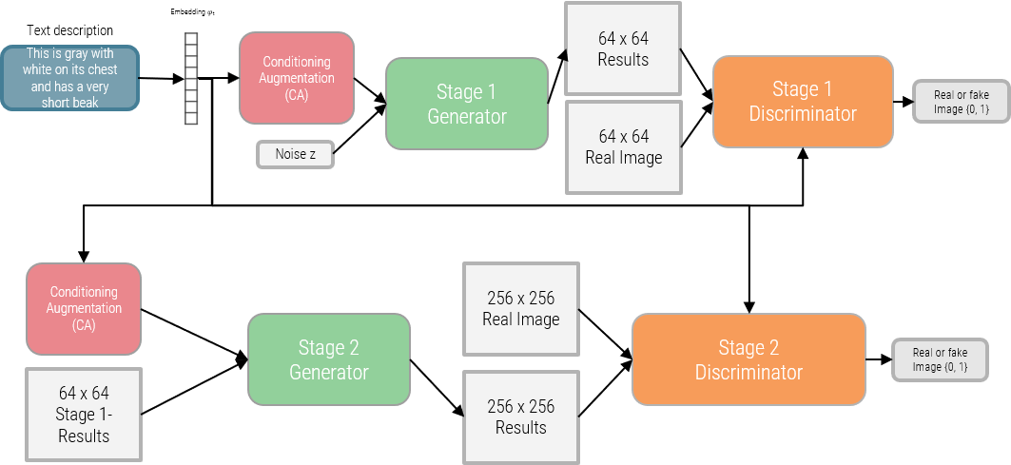
In simpler terms ..

Slide 15
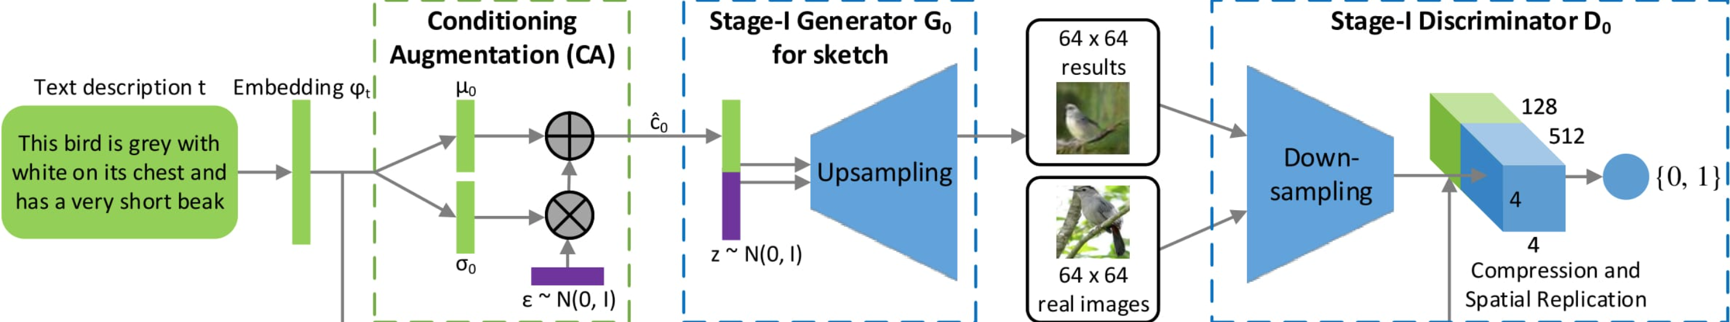
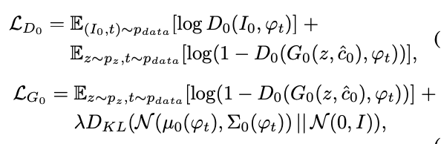
Stage 1 of the StackGAN
Instead of directly generating a high-resolution image conditioned on the text description, we simplify the task to first generate a low-resolution image with our Stage-I GAN, which focuses on drawing only rough shape and correct colors for the object.

Slide 16
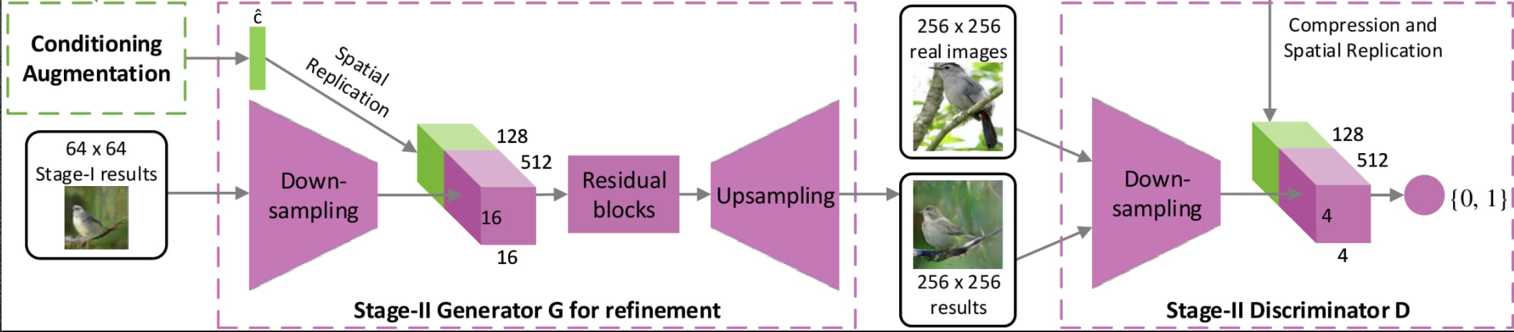
Stage 2 of the StackGAN
Low-resolution images generated by Stage-I GAN usually lack vivid object parts and might contain shape distortions. Some details in the text might also be omitted in the first stage, which is vital for generating photo-realistic images.
The Stage-II GAN is built upon Stage-I GAN results to generate high-resolution images. It is conditioned on low-resolution images and also the text embedding again to correct defects in Stage-I results. The Stage-II GAN completes previously ignored text information to generate more photo-realistic details.
The loss function remains the same replacing the Variables for the stage 2 generator and discriminator.

Slide 17
Model architecture (Generator)
We design Stage-II generator as an encoder-decoder network with residual blocks. Similar to the previous stage, the text embedding ϕt is used to generate the Ng dimensional text conditioning vector cˆ, which is spatially replicated to form a Mg×Mg×Ng tensor.
Meanwhile, the Stage-I result s0 generated by Stage-I GAN is fed into several down-sampling blocks (i.e., encoder) until it has a spatial size of Mg × Mg.
The image features and the text features are concatenated along the channel dimension.
The encoded image features coupled with text features are fed into several residual blocks, which are designed to learn multi-modal representations across image and text features.
Finally, a series of up-sampling layers (i.e., decoder) are used to generate a W ×H high-resolution image. Such a generator is able to help rectify defects in the input image while add more details to generate the realistic high-resolution image.

Slide 18
Model Architecture (Discriminator)
For the discriminator, its structure is similar to that of Stage-I discriminator with only extra down-sampling blocks since the image size is larger in this stage.
And then enforce GAN to learn better alignment between the image and the conditioning text.
During training, the discriminator takes real images and their corresponding text descriptions as positive sample pairs, whereas negative sample pairs consist of two groups.
The first is real images with mismatched text embeddings, while the second is synthetic images with their corresponding text embedding

Slide 19
Some images based on textual descriptions generated by the StackGAN trained on various datasets.

Slide 20
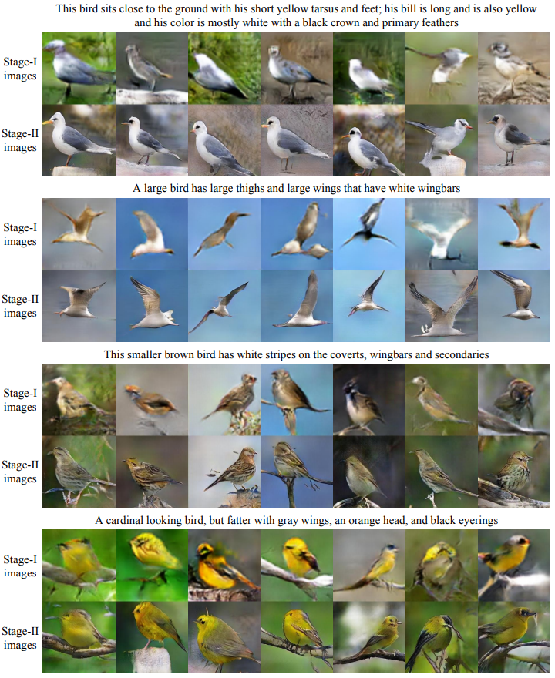
CUB DATASET

Slide 21
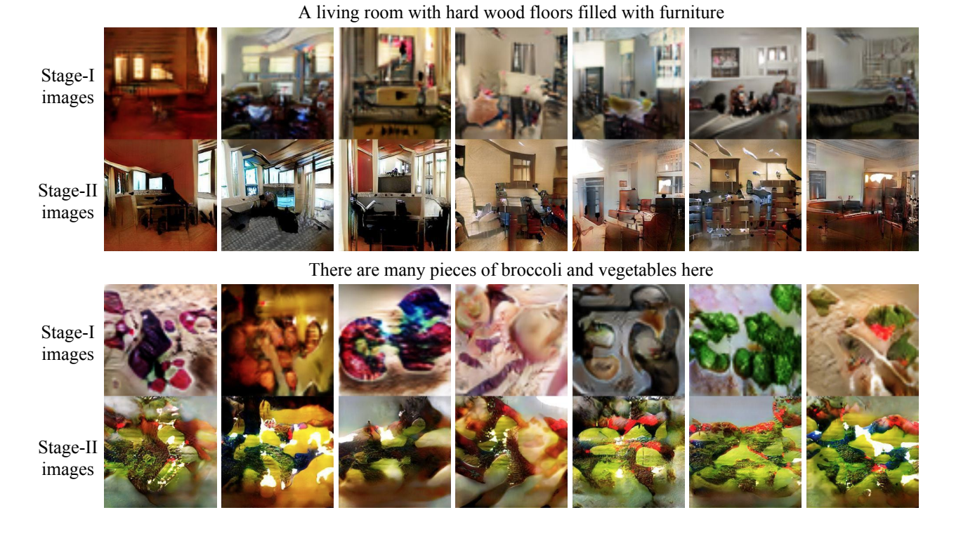
MS-COCO DATASET

Slide 22
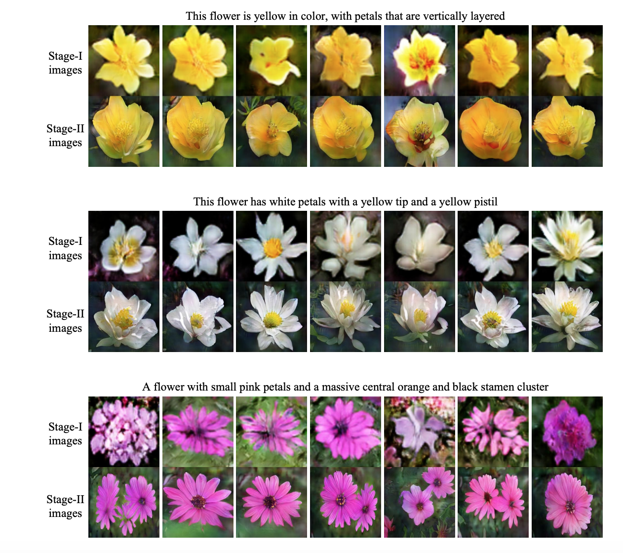
Oxford 102 Dataset

Slide 23
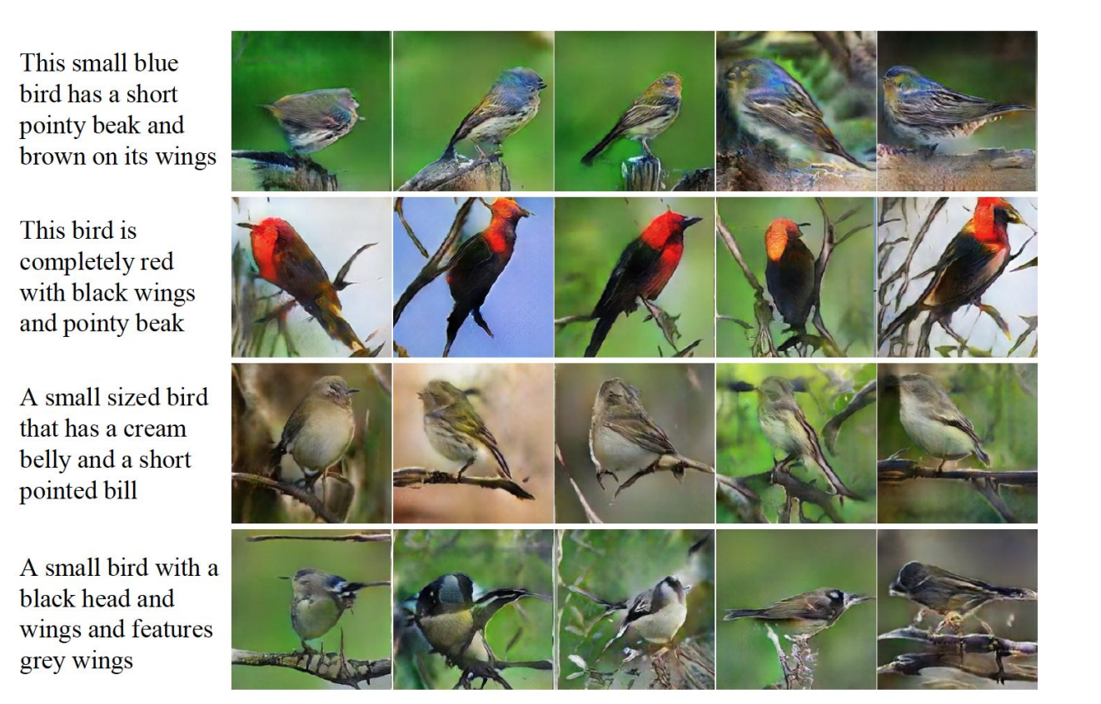
Variations due purely to Conditioning Augmentation
The noise vector z and the text encoding vector ᶨ are fixed for each row.
Only the samples from the distribution Ɲ(Ṍ(ᶨt ), ᵑ(ᶨt )) actually change between images

Slide 24
Problems with Evaluation/ assesments in GANs
Instead of being trained directly, the generator models are trained by a second model, called the discriminator, that learns to differentiate real images from fake or generated images. As such, there is no objective function or objective measure for the generator model.
This means that there is no generally agreed upon way of evaluating a given GAN generator model.
This is a problem for the research and use of GANs; for example, when:
Choosing a final GAN generator model during a training run.
Choosing generated images to demonstrate the capability of a GAN generator model.
Comparing GAN model architectures.
Comparing GAN model configurations.
The objective evaluation of GAN generator models remains an open problem

Slide 25
A Partial Solution
Using Inception Scores and Frechet Inception Distance
Both measures are easy to implement and calculate on batches of generated images. As such, the practice of systematically generating images and saving models during training can and should continue to be used to allow post-hoc model selection.

Slide 26
Inception Score
The score measures two things simultaneously:
The images have variety
Each image distinctly looks like something
If both things are true, the score will be high. If either or both are false, the score will be low.
To produce this score, we use a statistics formula called the Kullback-Leibler (KL) divergence . The KL divergence is a measure of how similar/different two probability distributions are.
KL divergence which is calculated as:
KL (divergence) = p(y|x) * (log(p(y|x)) – log(p(y)))

Slide 27
Frechet Inception Distance
As, Inception Score has a lot of limitations, FID score is implemented which is now the standard for measuring the performances of GANs today
In FID, we use the Inception network to extract features from an intermediate layer.
Then we model the data distribution for these features using a multivariate Gaussian distribution with mean µ and covariance Σ.
The FID between the real images x and generated images g is computed as:
Lower FID values mean better image quality and diversity.
Better than Inception Score as it is robust to noise, image distortions, and perturbations.
A good metric for diverse datasets
Computationally efficient
Can detect intra-class mode dropping

Slide 28
How does the StackGAN match up
Metrics | CUB |  |  | Oxford |  | COCO
Model Used → | GAN-INT-CLS | GAWWN | StackGAN | GAN-INT-CLS | StackGAN | GAN-INT-CLS | StackGAN
FID ↓ | 68.79 | 67.22 | 51.89 | 79.55 | 55.28 | 60.62 | 74.05
FID# ↓ | 68.79 | 53.51 | 35.11 | 79.55 | 43.02 | 60.62 | 33.88
IS ↑ | 2.88 ± .04 | 3.62 ± .07 | 3.70 ± .04 | 2.66 ± .03 | 3.20 ± .01 | 7.88 ± .07 | 8.45 ± .03
IS# ↑ | 2.88 ± .04 | 3.10 ± .03 | 3.02 ± .03 | 2.66 ± .03 | 2.73 ± .03 | 7.88 ± .07 | 8.35 ± .11
HR ↓ | 2.76 ± .01 | 1.95 ± .02 | 1.29 ± .02 | 1.84 ± .02 | 1.16 ± .02 | 1.82 ± .03 | 1.18 ± .03
This is a limited functionality evaluation no set metrics is available for testing and evaluating GANs

Slide 29

Quick Look at some extra Maths in the Progress Report

Slide 30

Demerits / Drawbacks
No instantaneous results of a manual textual description
Training takes a long time!
No agreed upon evaluation parameters
Scalability issues :A working deployed StackGAN would still take time to generate results.
And the Biggest one of them all: Training Mechanical power , Graphical Power.
Due to the limited availability of resources during quarantine training was done on my own PC , laptops and using Google Collab
The training is very graphically intensive and requires good graphical hardware to do the same
The training process takes hours to come up with a distinctive response to the text.
Would improve by a lot if performed in a proper lab.
30

Slide 31
Conclusion / Future Plan
After the analysing the scores (FID & Inception scores) we can see how the StackGAN improves the GAN architecture and increases the resolution and improves the image quality by a lot as we can see by the trained models’ images generated.
Compared to existing text-to-image generative models, StackGAN generates higher resolution images (e.g., 256×256) with more photo-realistic details and diversity.
The double stage GAN proves to be a crucial part in improving the scores by a huge margin. The double structure consisting of 2 generators and 2 discriminators upsamples the image to a higher resolution (256x256) instead of the low-res(64x64) image generated by the DC-GAN.
StackGAN is a powerful concept and the fact that they are able to create such photo-realistic images from the text is simply incredible.
Moreover, training and implementing other GANs like the OP-GAN, AttnGAN, BigGAN or combing StackGAN with other models etc for the current objective of generating photo-realistic images from textual descriptions (combing GANs with CLIP).

Slide 32


